Slide 1

Data visualisation
Basic concepts

Slide 2
Design for the human brain!

Slide 3
Design for the human brain!

Slide 4
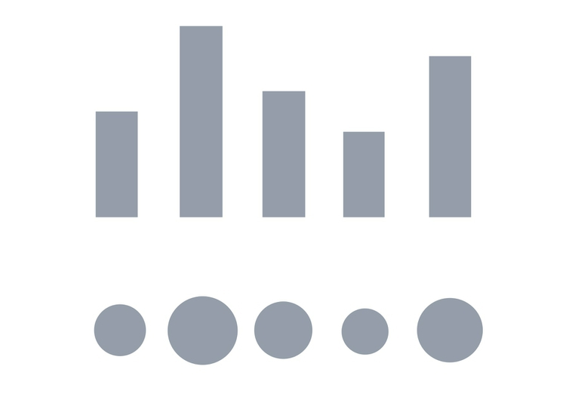
Design for the human brain!

Slide 5
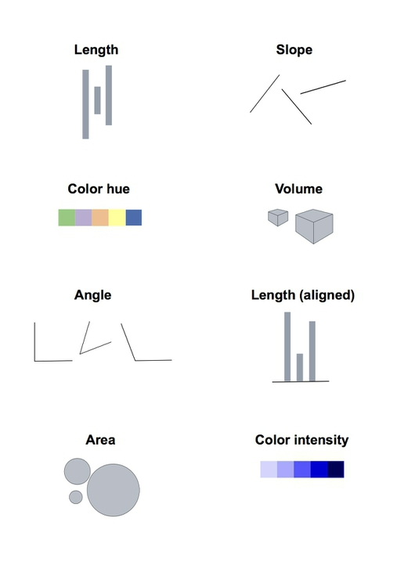
Visualization
Not all visual cues are created equal

Slide 6
Visualization
Not all visual cues are created equal

Slide 7
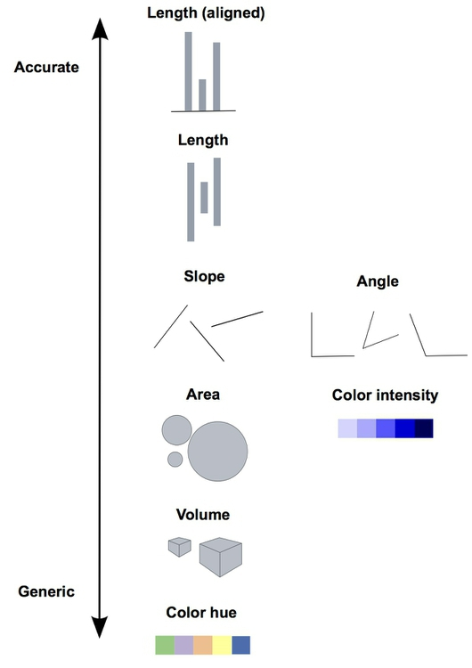
Visualization
Encoding data using visual cues

Slide 8
So, all bar charts, all the time?
No (duh)
Trivially: Not everything is a quantity
And not all numbers are quantities

Slide 9
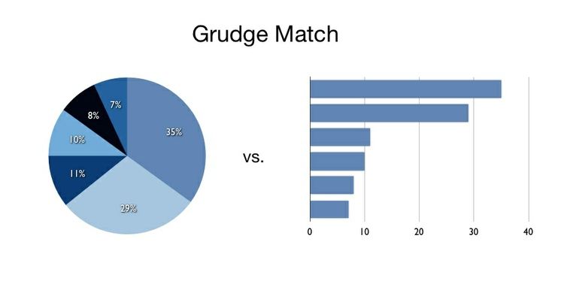
But one thing is sure
No pie charts

Slide 10
But one thing is sure
No pie charts

Slide 11
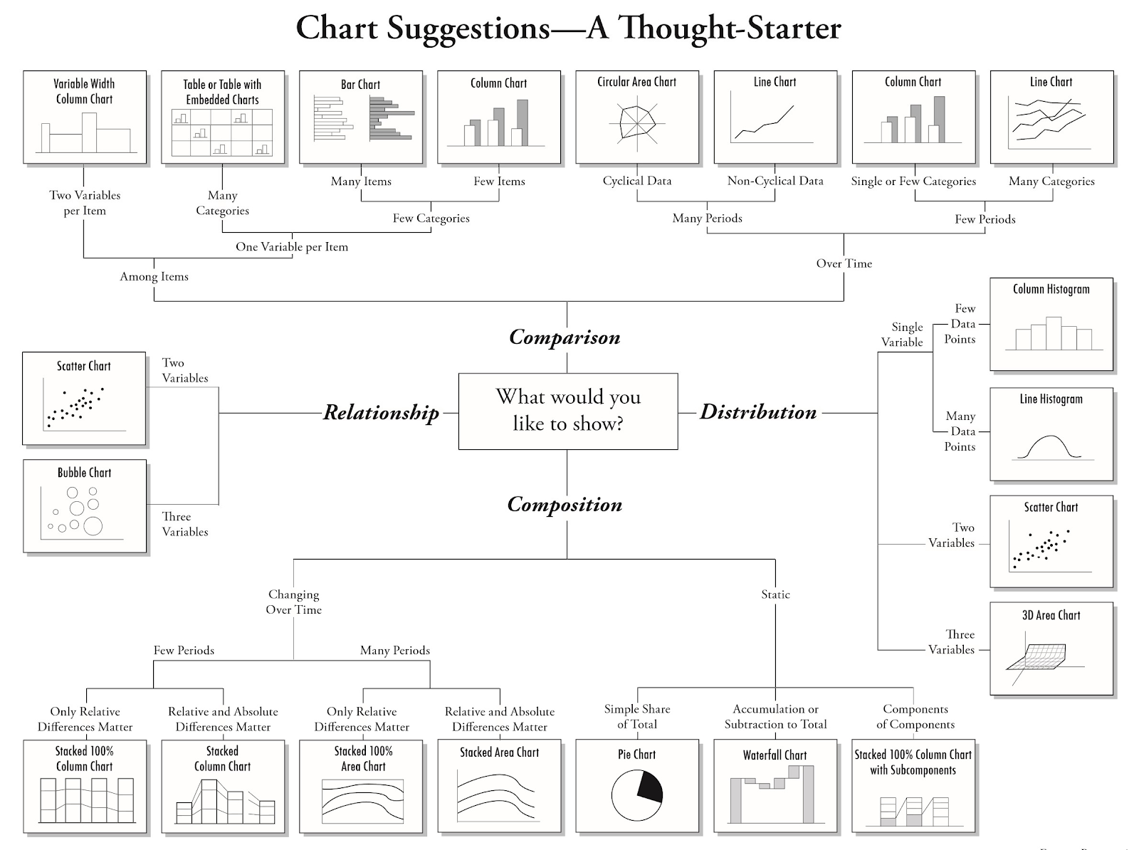
Source: https://alearningaday.blog/2016/03/23/no-pie-charts/

Slide 12
Source: https://alearningaday.blog/2016/03/23/no-pie-charts/

Slide 13
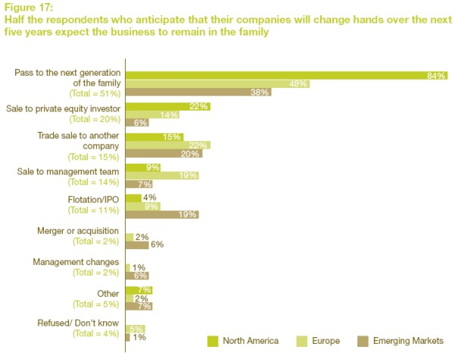
Think about where the story is
Source: http://www.plainfigures.com/exampleone.html

Slide 14
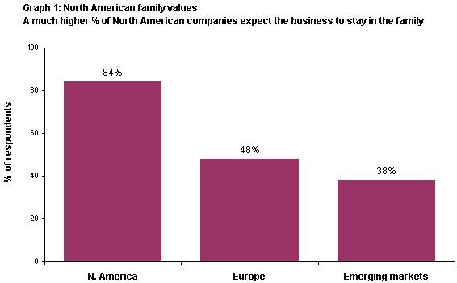
Think about where the story is
Source: http://www.plainfigures.com/exampleone.html

Slide 15
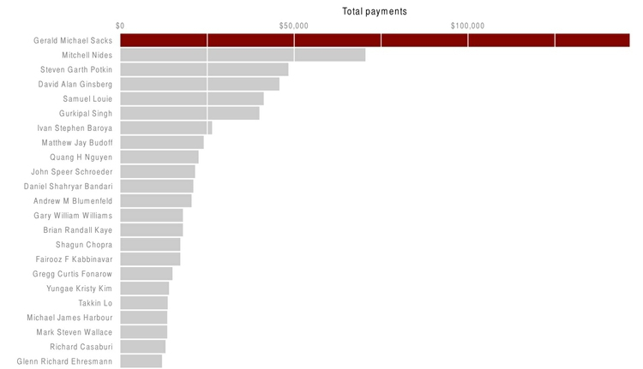
Simple comparisons: bars and columns

Slide 16
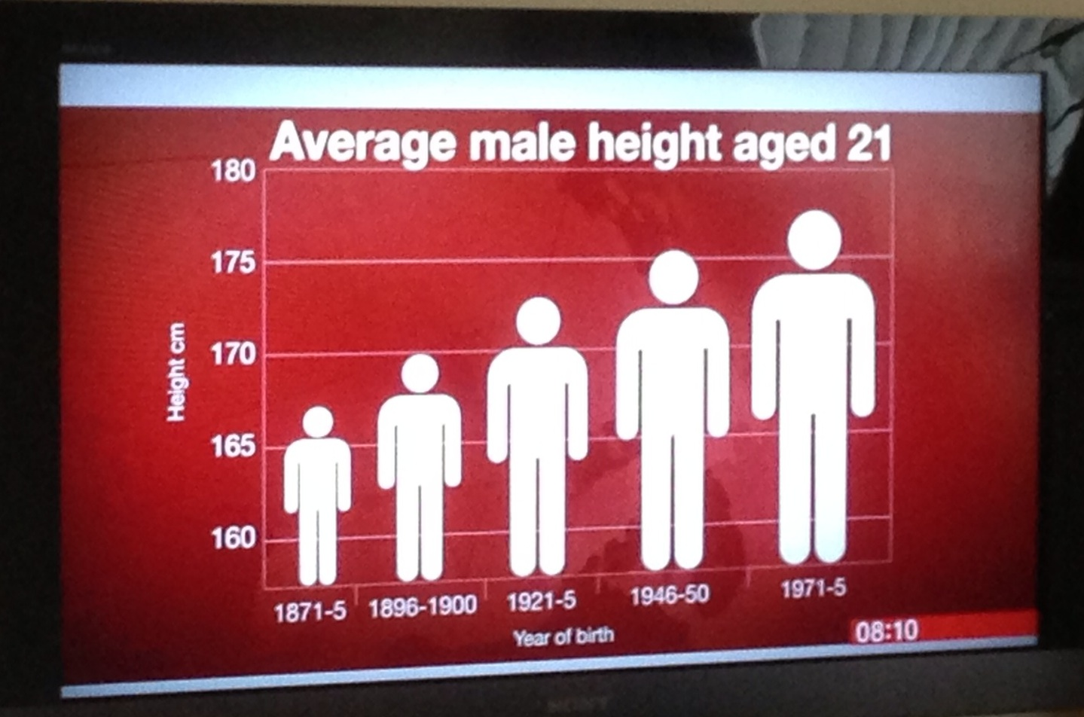
Simple comparisons: bars and columns
But keep it honest

Slide 17
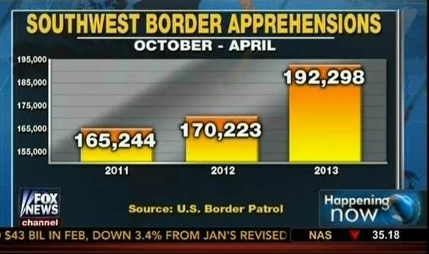
Simple comparisons: bars and columns
But keep it honest

Slide 18
Simple comparisons: bars and columns
But keep it honest

Slide 19
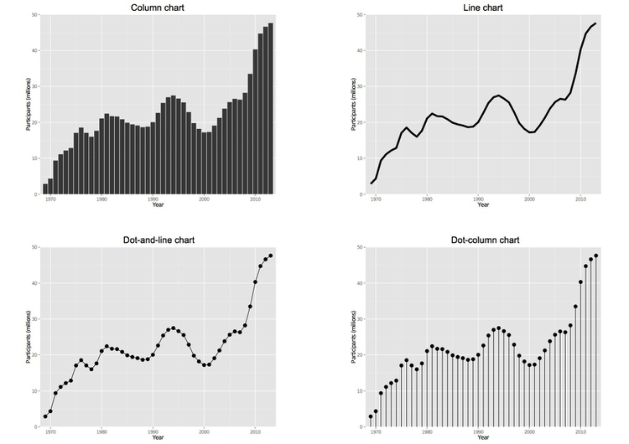
Comparisons: change over time

Slide 20
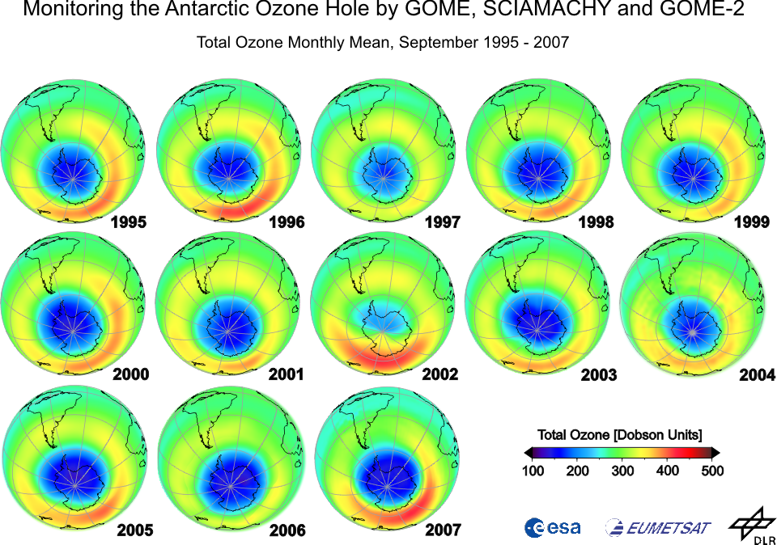
Multiple comparisons including change over time

Slide 21
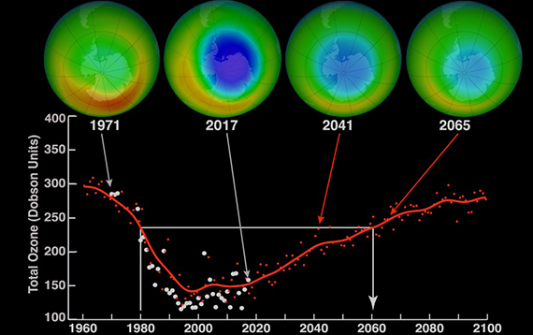
Multiple comparisons including change over time

Slide 22
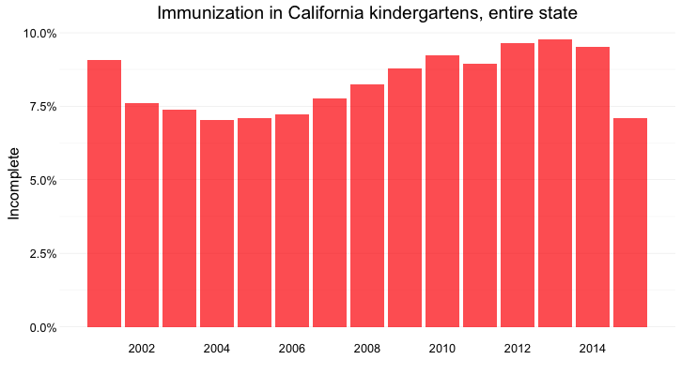
Comparisons: change over time

Slide 23
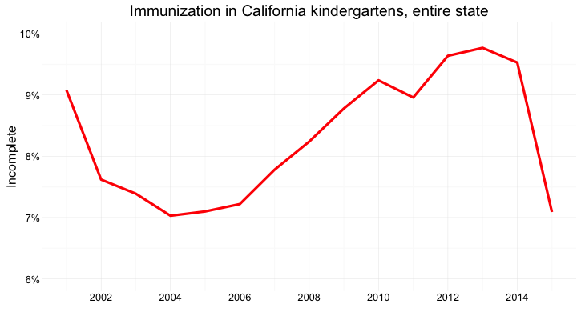
Comparisons: change over time

Slide 24
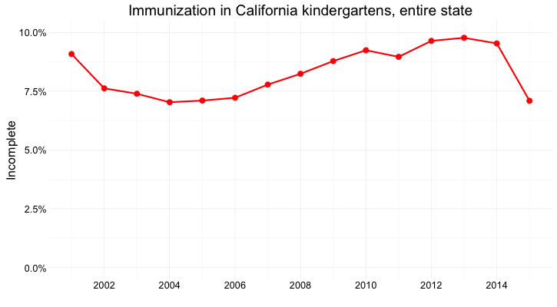
Comparisons: change over time

Slide 25
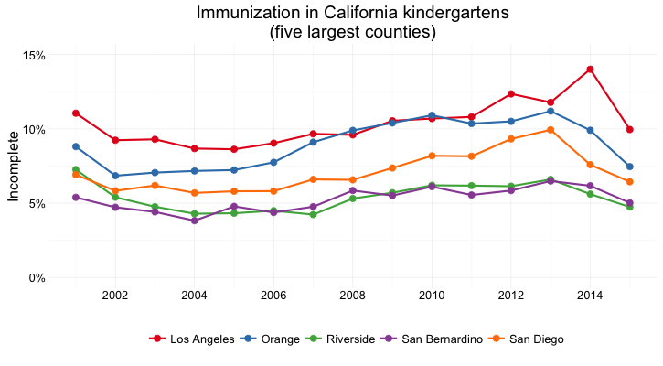
Comparisons: change over time

Slide 26
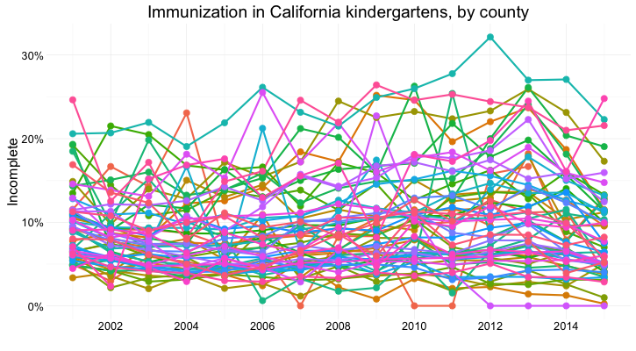
Comparisons: change over time

Slide 27
Comparisons: change over time
Not going to win you any hackathons

Slide 28
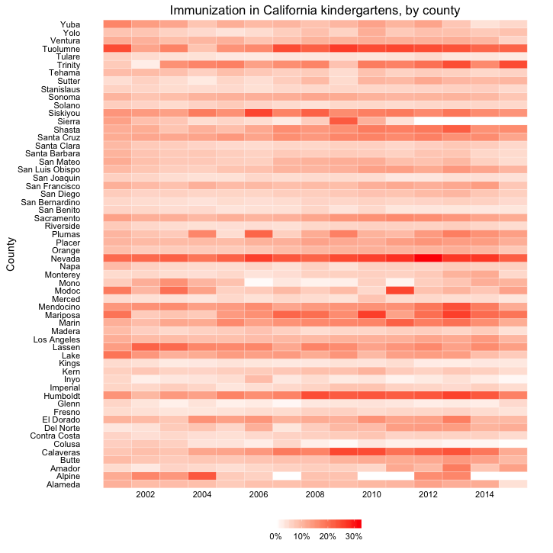
Comparisons: change over time

Slide 29
Comparisons: change over time
Probably also not going to win you any hackathons

Slide 30
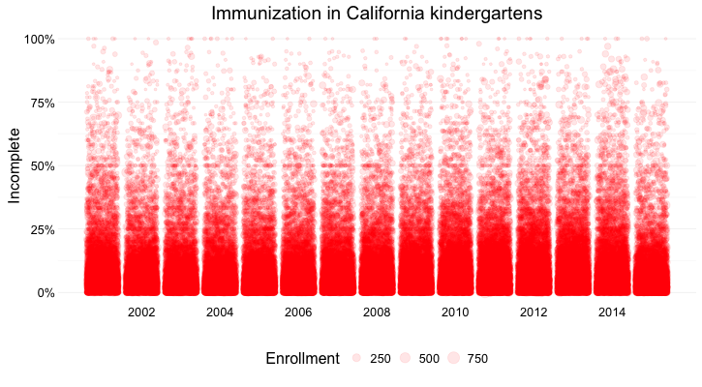
Experiment!

Slide 31
Use of color

Slide 32
Use of color

Slide 33
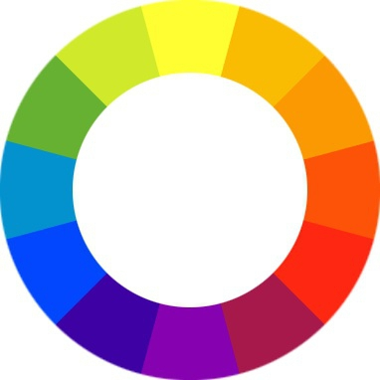
Use of color

Slide 34
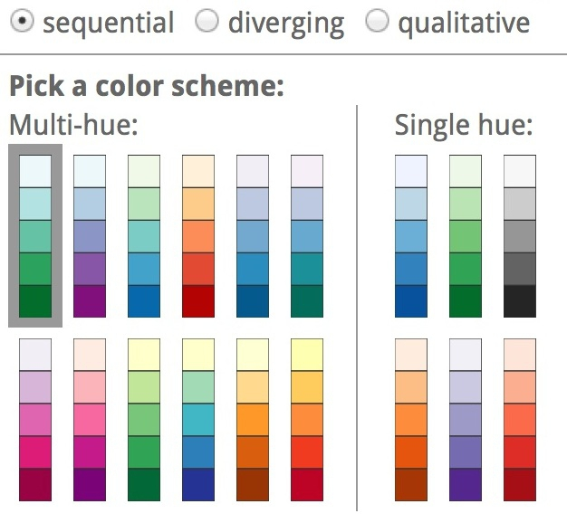
Use of color

Slide 35
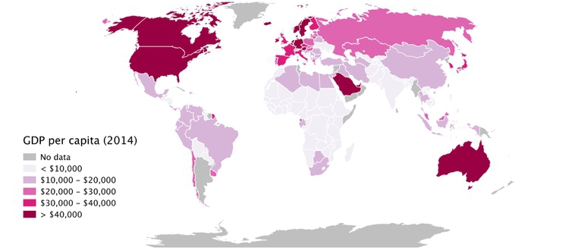
Experiment with different scales

Slide 36
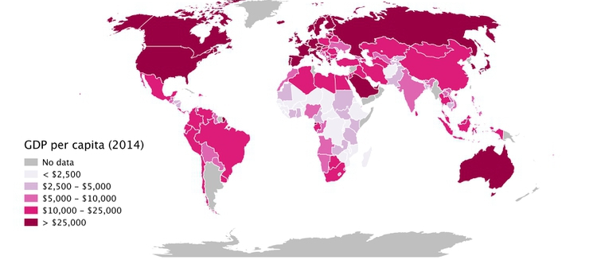
Experiment with different scales

Slide 37
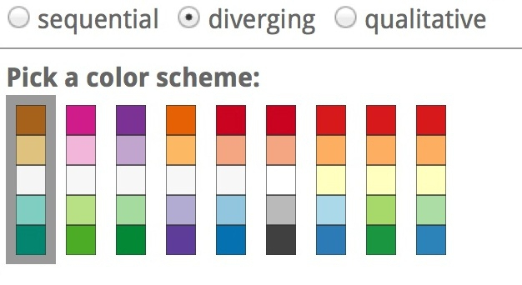
Use of color

Slide 38
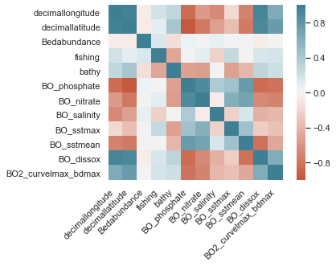
Use of color

Slide 39
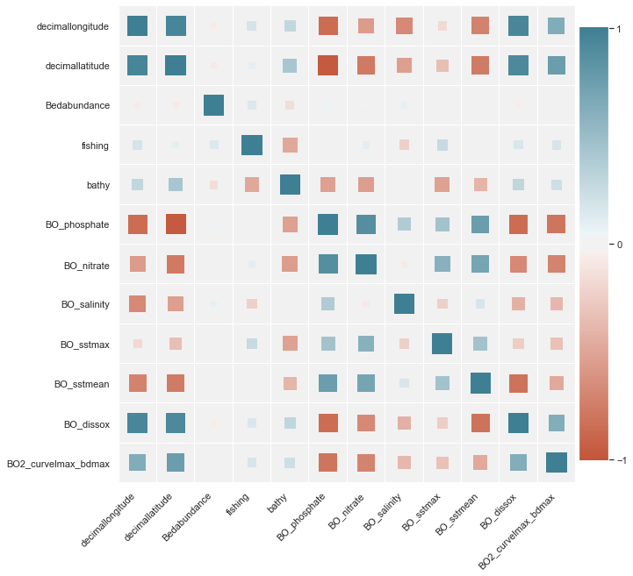
Use of color
Sneak preview of a better correlation matrix from the machine learning workshop

Slide 40
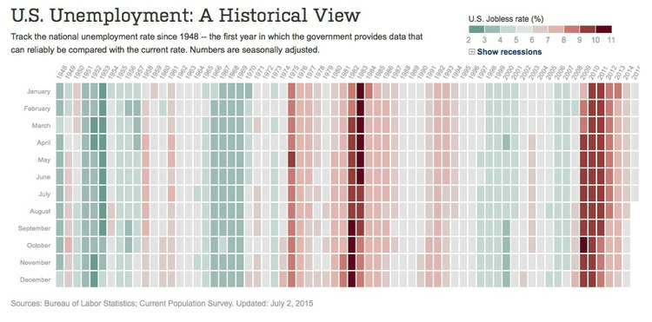
Use of color

Slide 41
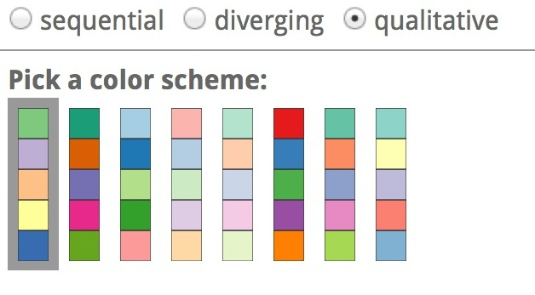
Use of color

Slide 42
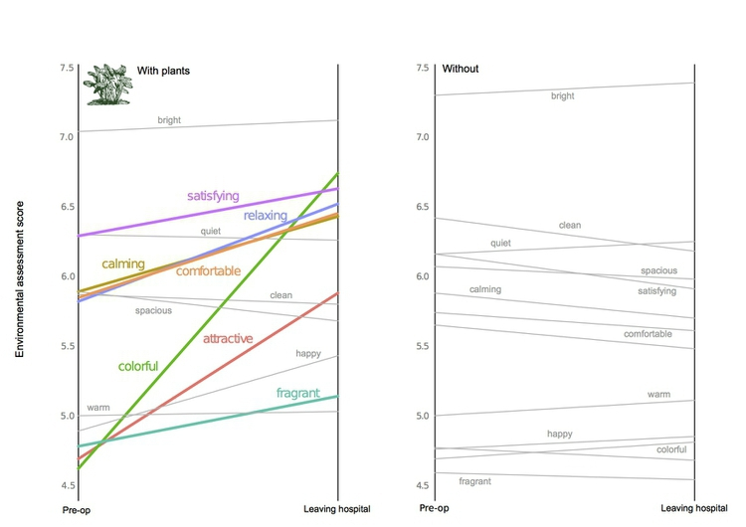
Side by side

Slide 43
Scatterplot

Slide 44
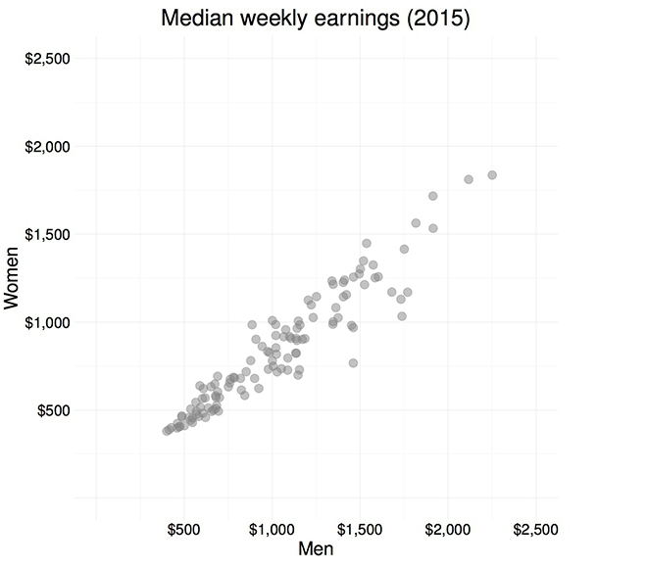
Scatterplot

Slide 45
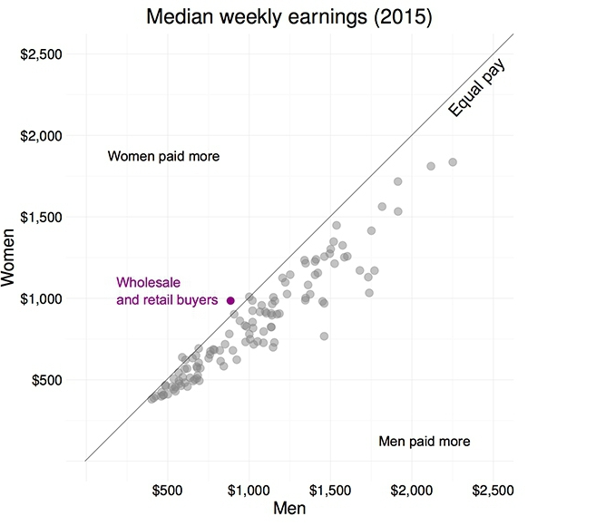
Scatterplot

Slide 46
Scatterplot

Slide 47
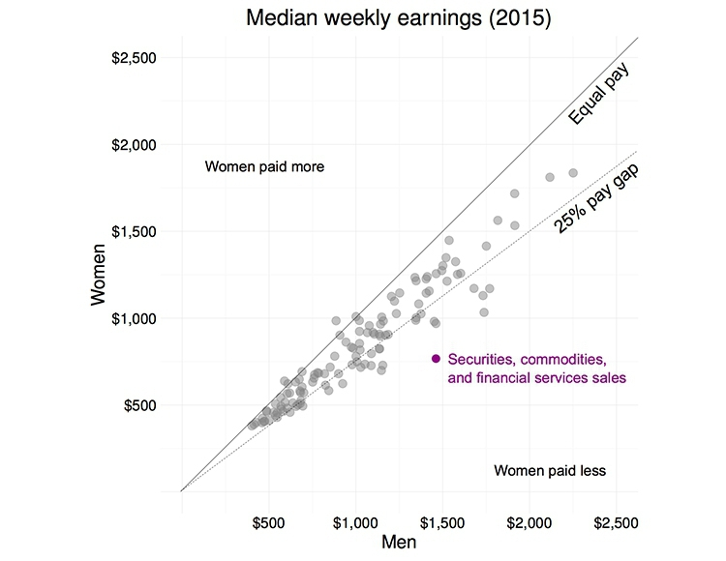
Scatterplot

Slide 48
Scatterplot

Slide 49
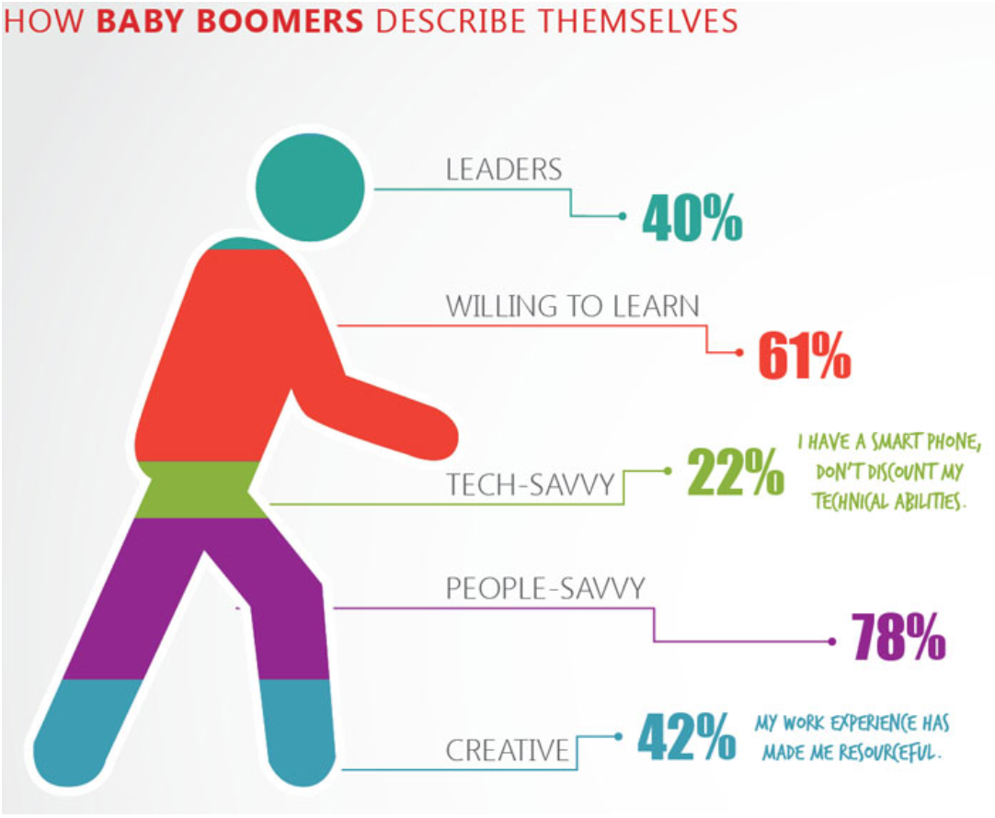
So, what’s wrong with this picture?

Slide 50
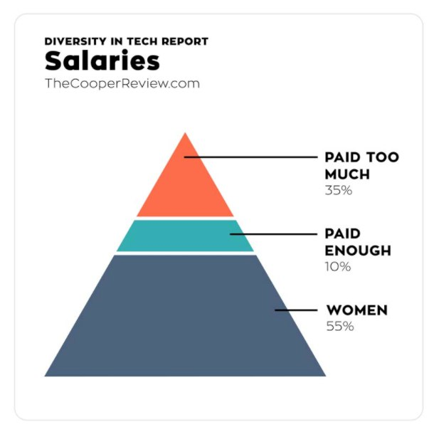
Sometimes, it’s not only the visualization

Slide 51
Today’s agenda
Lennert Schepers – Rshiny
AltAir google colab python notebook
http://tiny.cc/OSL2019DV

Slide 52
THANK YOU

